Slide 1
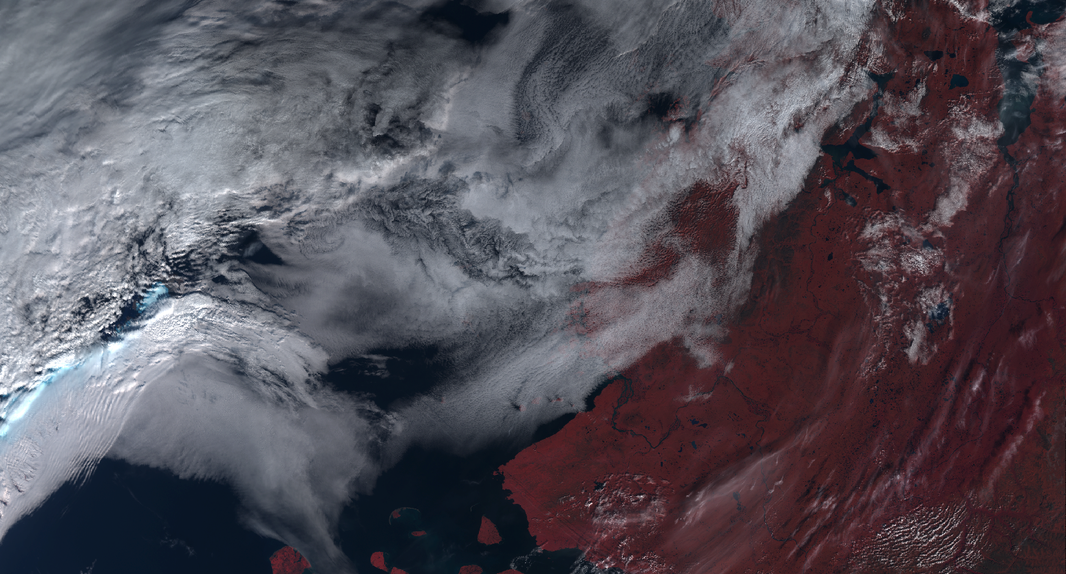
Material for Meeting
14th January 2019

Slide 2
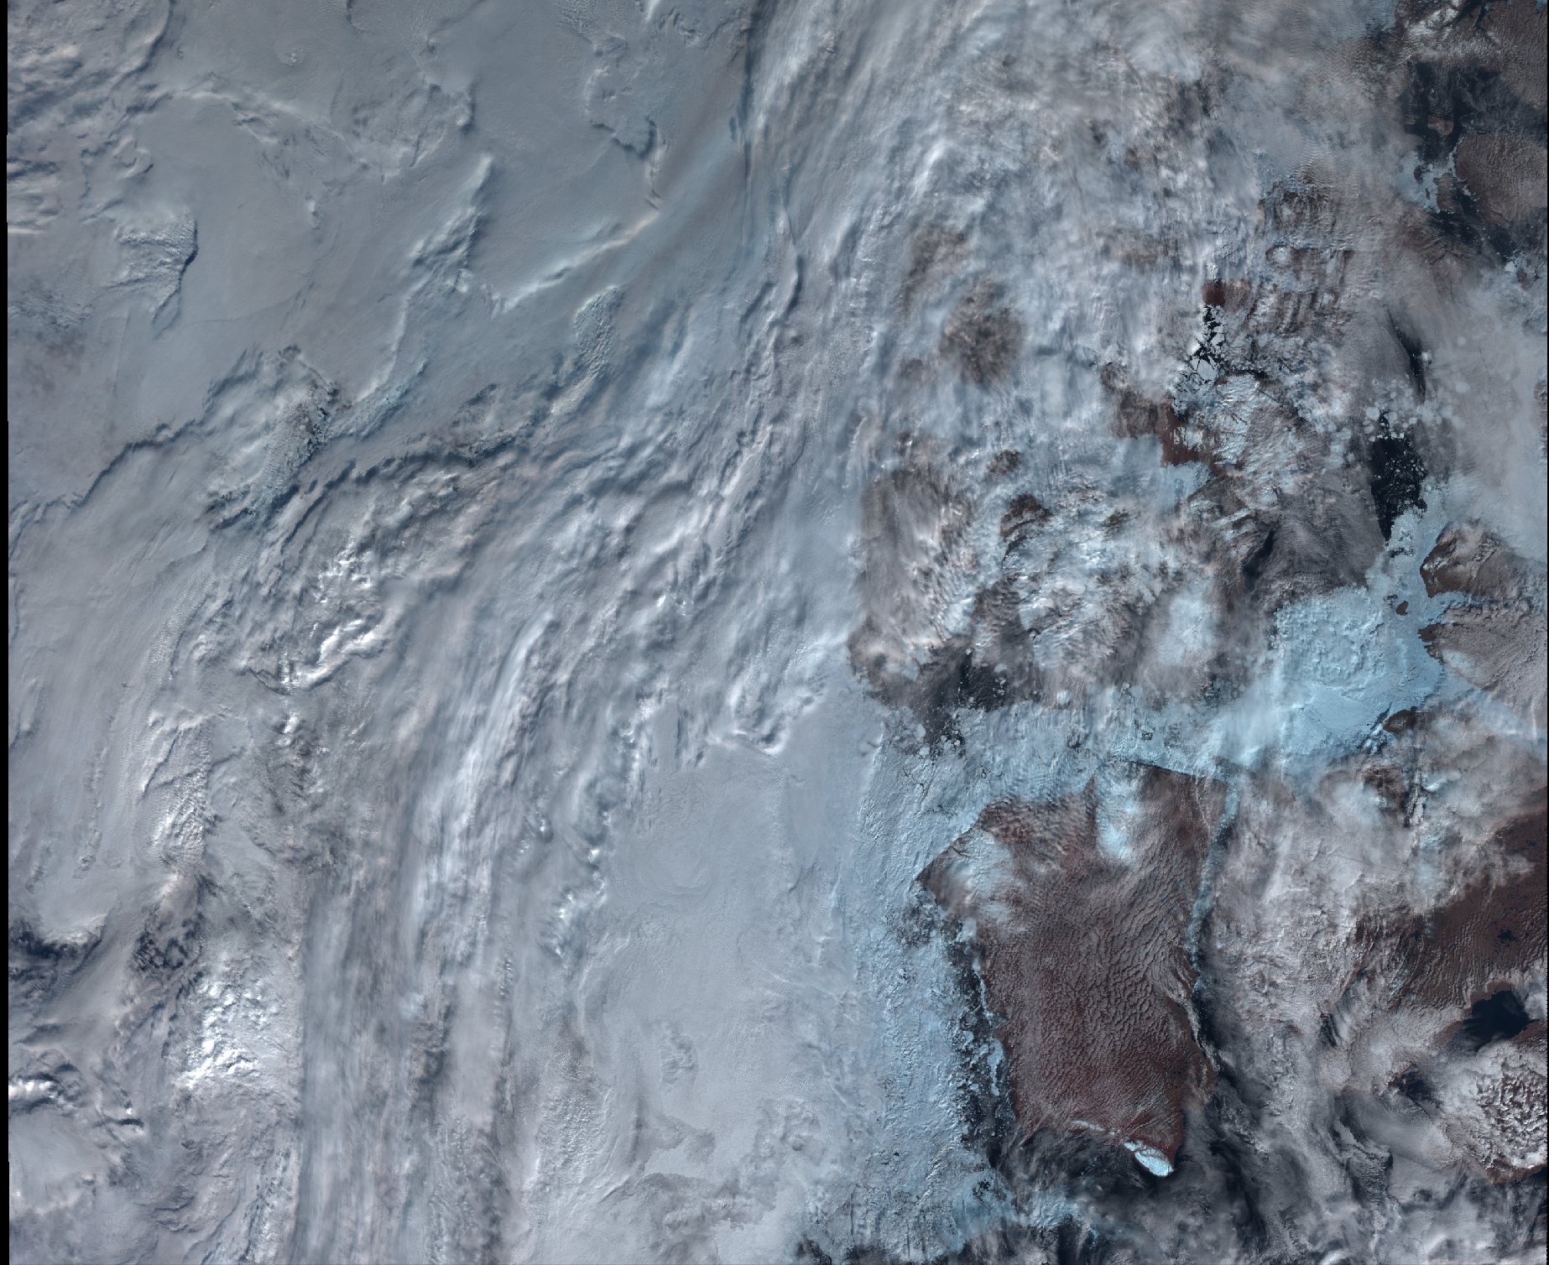
Summary
Aim
Data
Example plots
Accuracy
Reproducibility
Application speed
Future directions
Housekeeping

Slide 3
1. Aim
Identify clouds in satellite images between 60 and 90° absolute latitude using machine learning.
Artificial Neural Networks (ANN)
Deep Feed Forward Network (FNN) or Multi-Layer Perceptron (MLP)
Making predictions on SLSTR images (Sentinel 3A and B)
Training the model using CALIOP data (CALIPSO)

Slide 4
2. Data processing
Calipso data is downloaded from https://search.earthdata.nasa.gov/ ~16GB per month (day files only).
Matches are found using ESA queries ~ 1 hour per month of data. The matches are stored in .txt format.
The identified SLSTR files are downloaded. This is the slowest part of the process ~ 7 hours
Once all files are downloaded, the collocation is performed on the paired files and the relevent pixels are stored. This takes ~ 1 hour and produces the output .pkl files.

Slide 5
https://docs.google.com/spreadsheets/d/1W3gyqzpbKeNRWvtOrYsDbg2UzzVLfw-t74esUQ_12GU/edit#gid=0
2.8 million collocated pixels recorded with 33 variables stored after > 2 TB processed
764 MB pandas dataframe

Slide 6
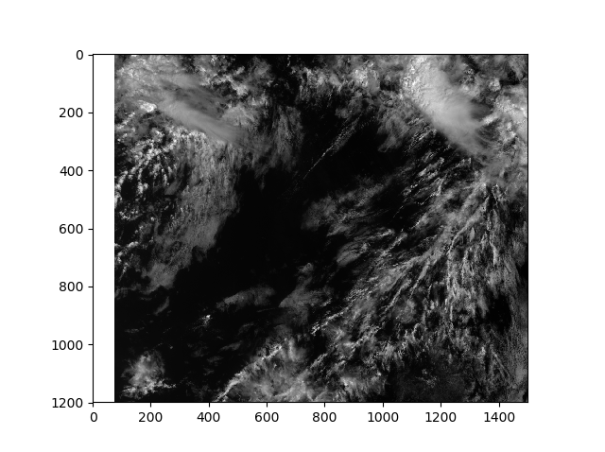
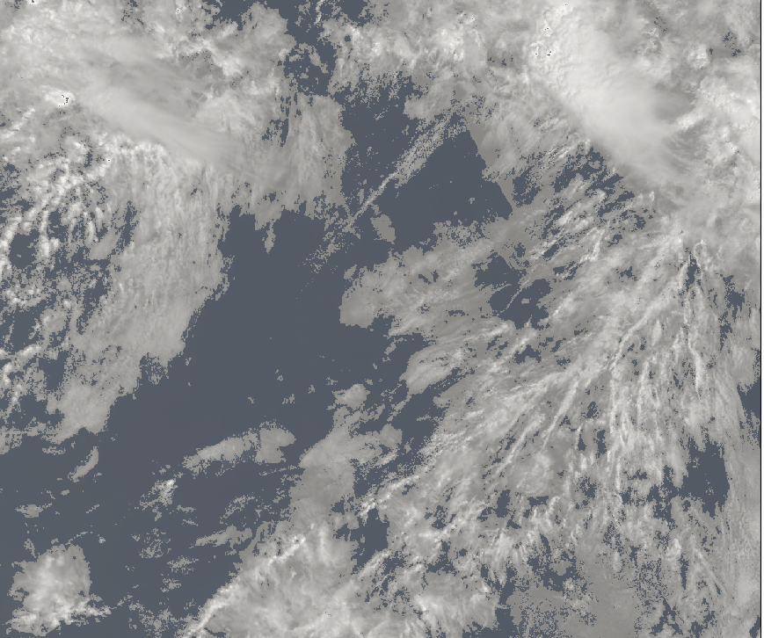
3. Example plots
Left: Generated mask
Right: S1_an channel data

Slide 7
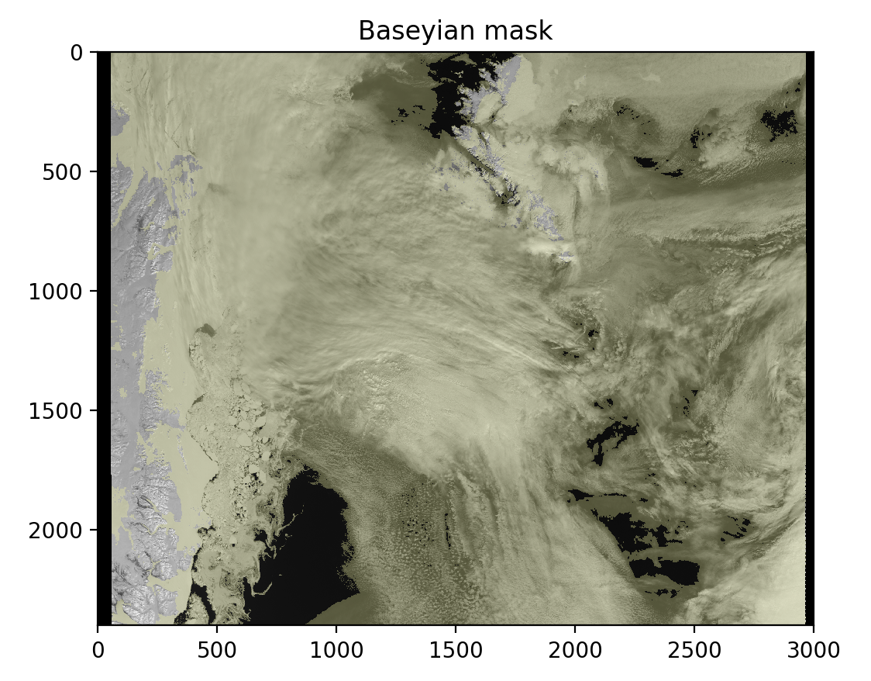
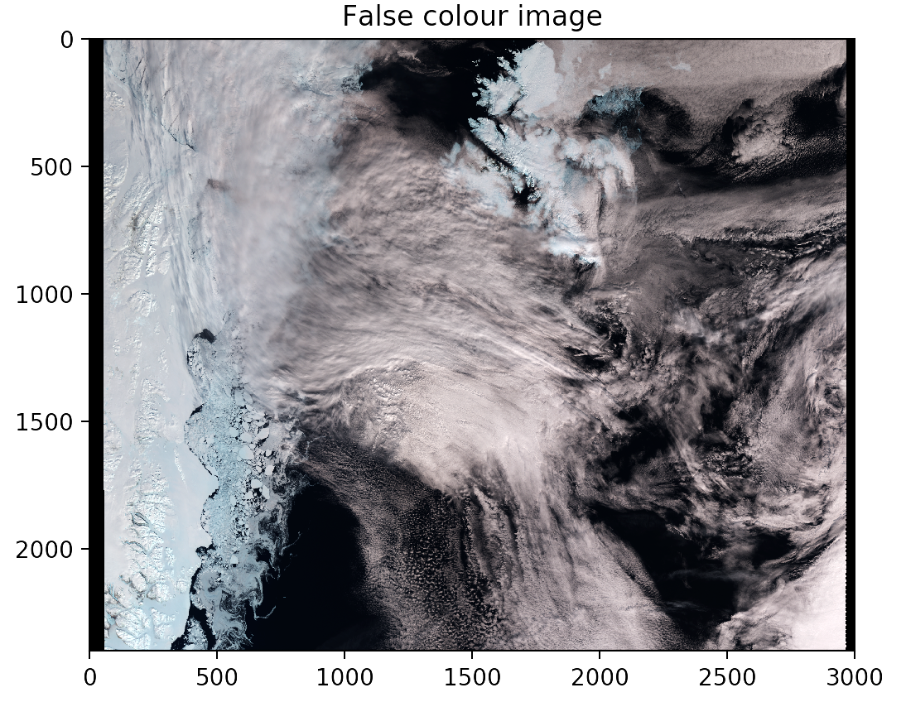
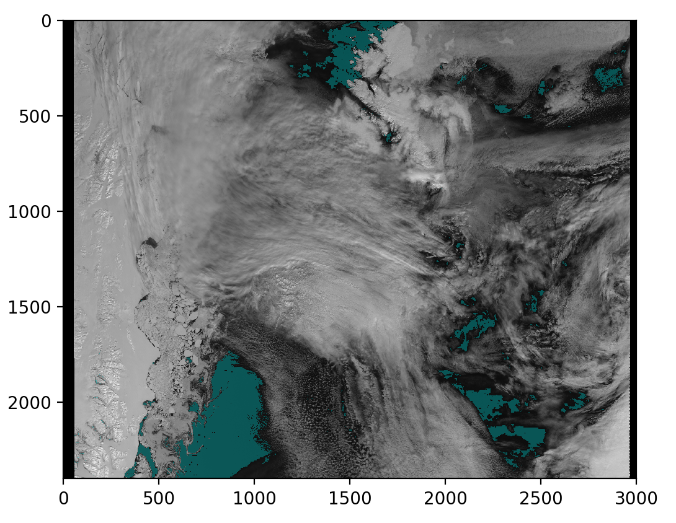
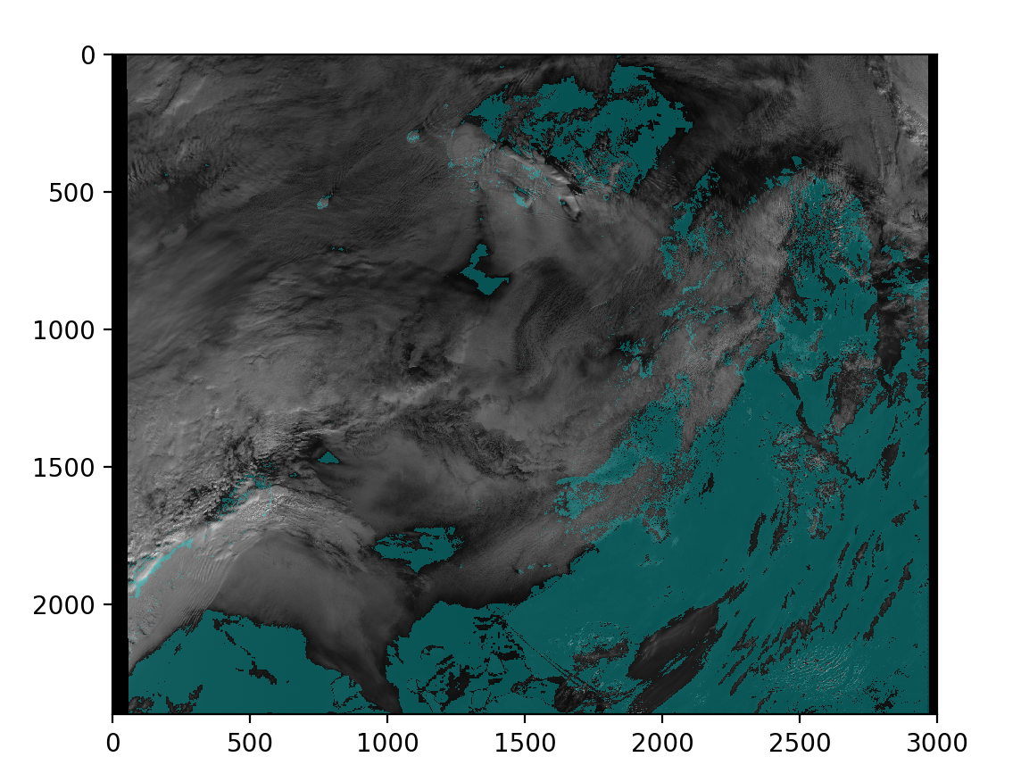
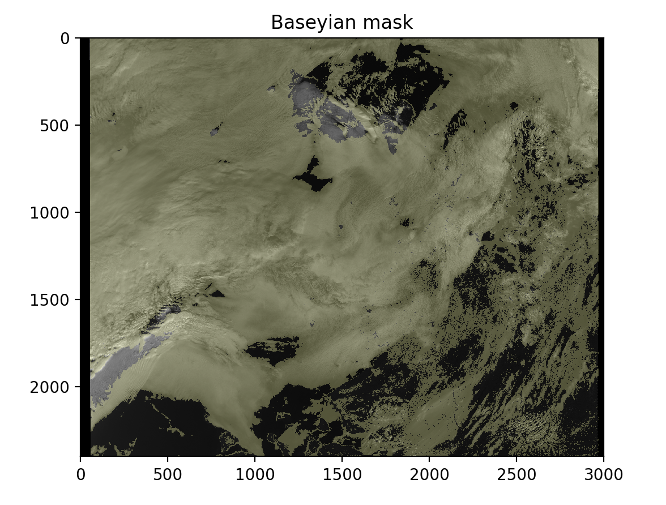
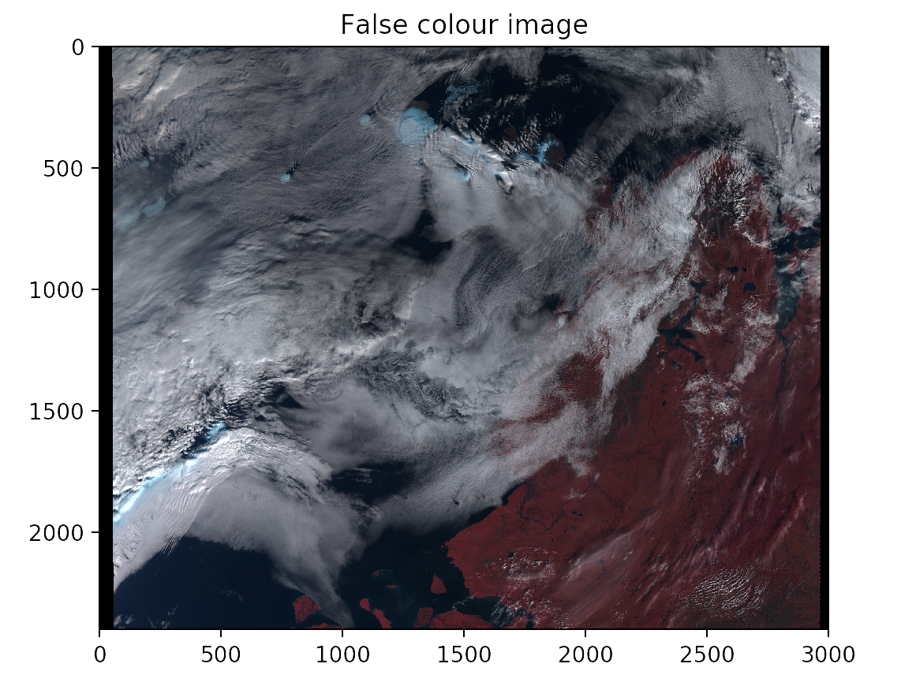

Slide 8
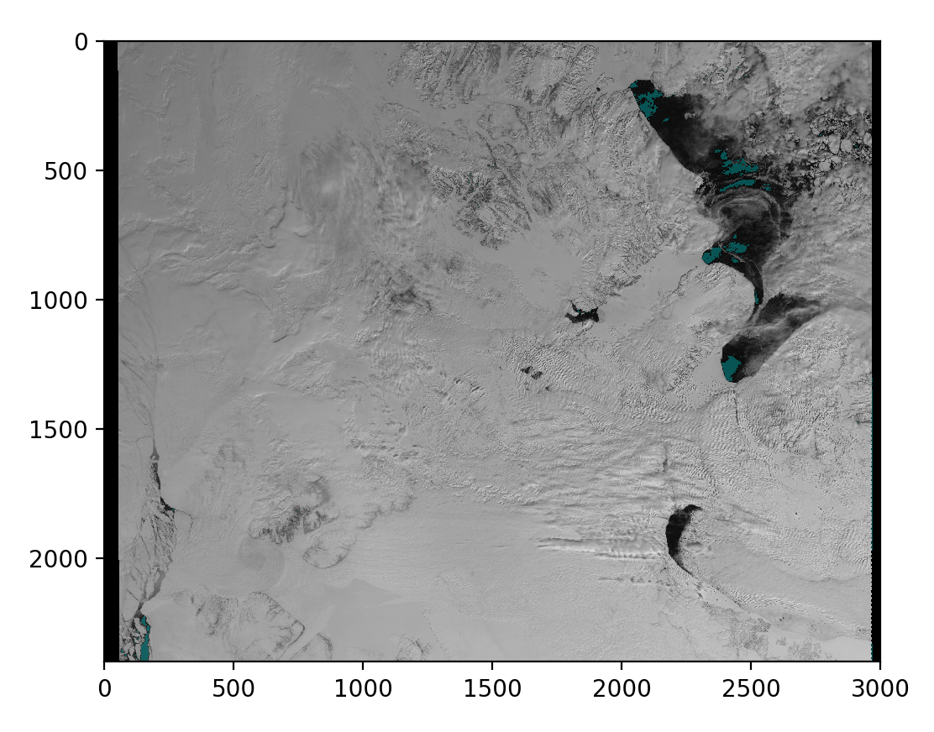
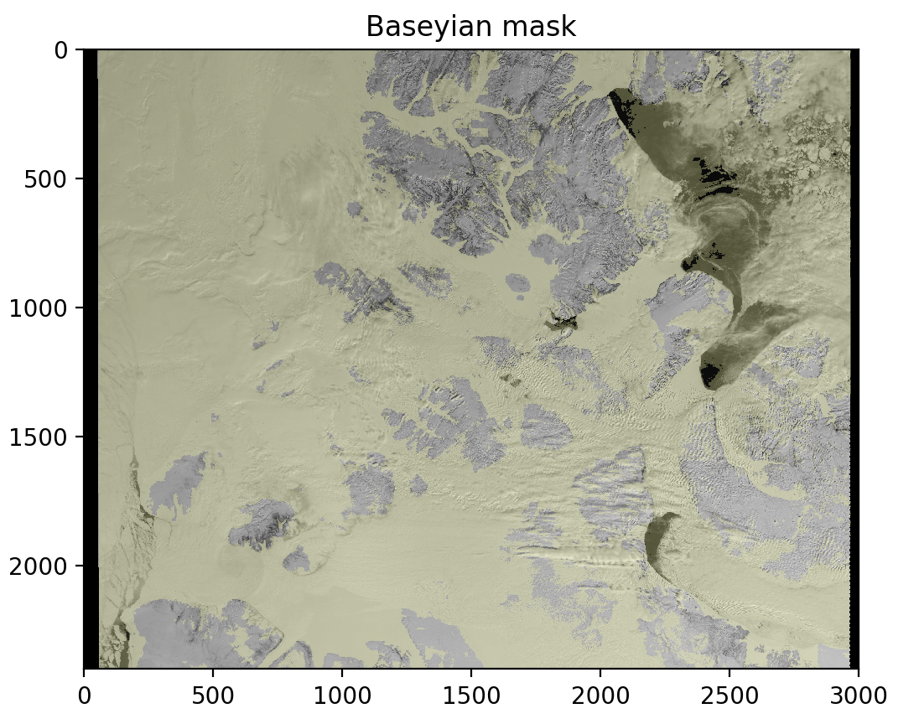
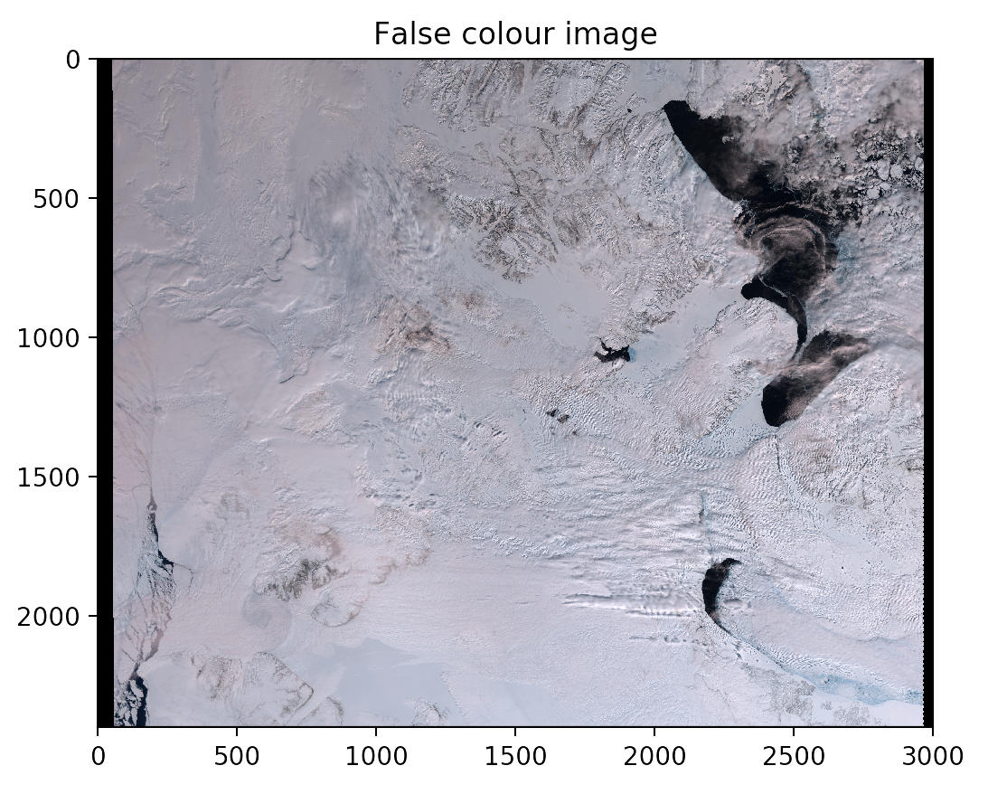
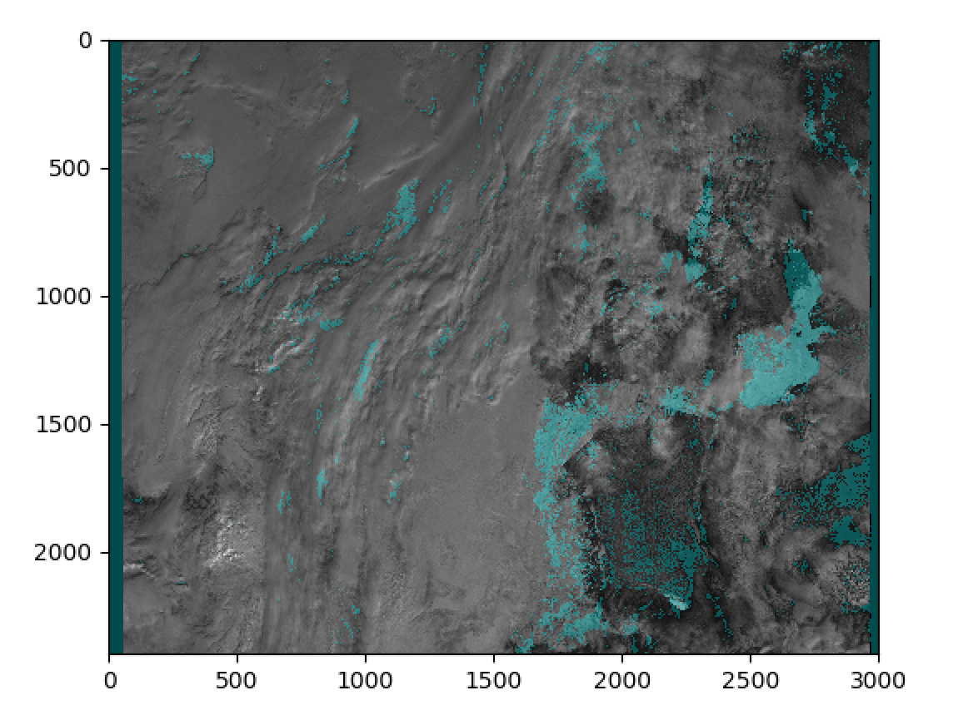
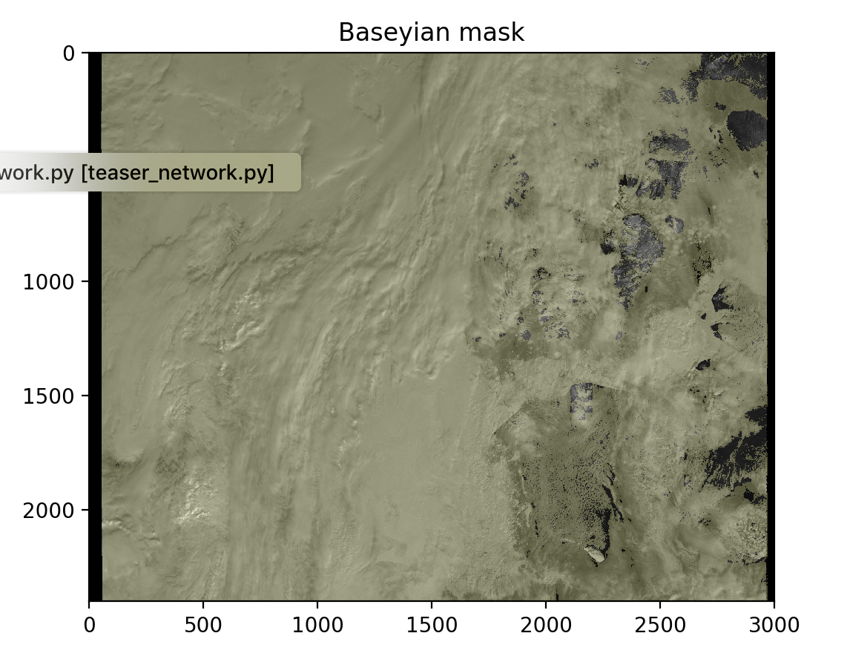
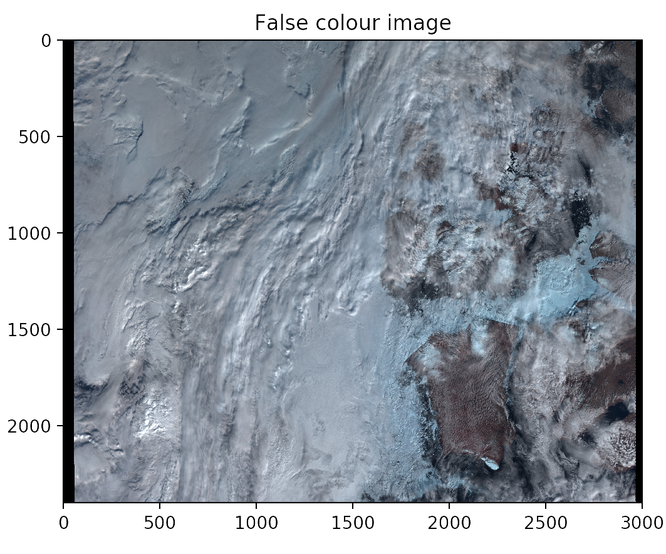

Slide 9
4. Accuracy

Slide 10
5. Reproducibility

Slide 11
6. Application speed

Slide 12
7. Future directions
Create a Convolutional Neural Network (CNN) to take into account

Slide 13
8. Housekeeping
We are free next term:
Monday morning
Tuesday between 2 and 5pm
Wednesday (all day except 11 to 12 pm)
Thursday after 2pm
Friday morning
Last meeting with Prof Egede Tuesday at 2pm

